Slide 1
Agenish’ s Request DCN issues Distribution targets are triggered for all plant views End item business rule
20-Dec-2024

Slide 2
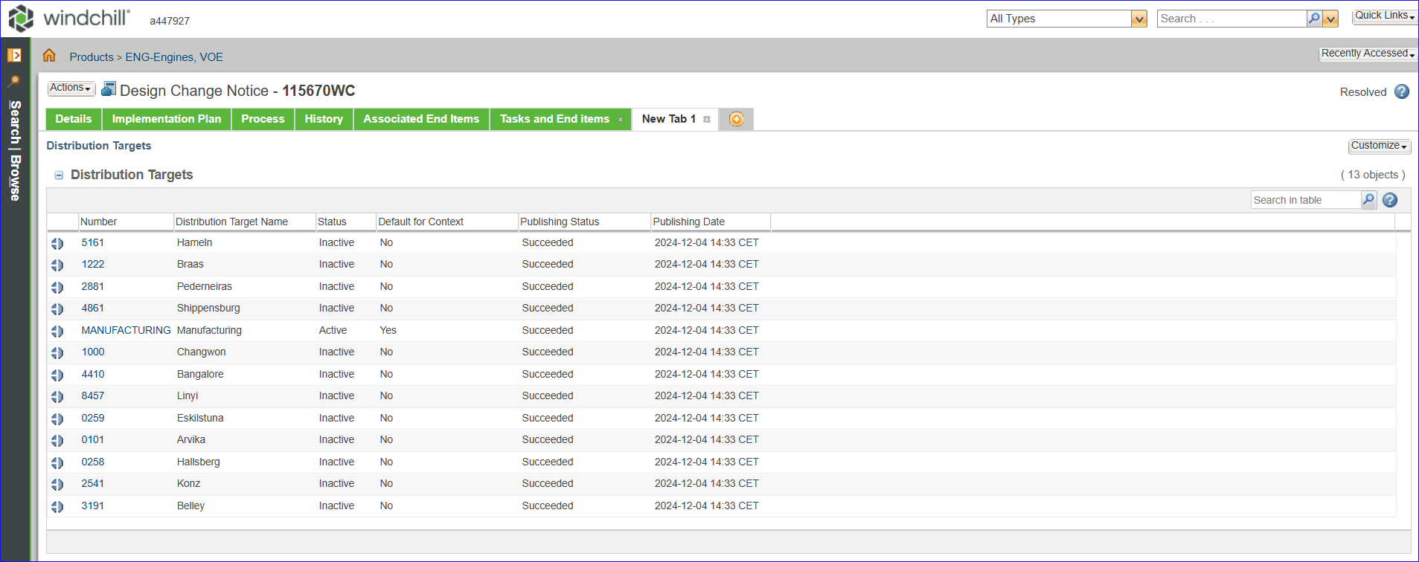
We observed a couple of issues with DCN this morning together with Anton. Below are the issues
Distribution targets are triggered for all plant views – It should be only triggered for manufacturing but in our current case in the below DCN we see it has been triggered for all plants which can happen only if there are downstream equivalents for the resulting object and in this case it hasn’t any. Based on a discussion with Sithik, I have inactivated the plant distribution targets as a workaround so that we send them to ODC/FM moving forward. Can you please further analyze the DCN and see when this was changed? Can you also create a bug with an analysis?
115670WC
End item business rule – Generally if we have Volvo part in the DCN there is a business rule to check if it has an end item associated with it, but I see that rule missing in the DCN(highlighted) here, I quickly looked at the code and it seems to be a viable candidate to have the rule conflict but in prod it doesn’t happen today. Please analyze further on this and create a bug if you see that it’s working otherwise.
Regards
Agenish

Slide 3
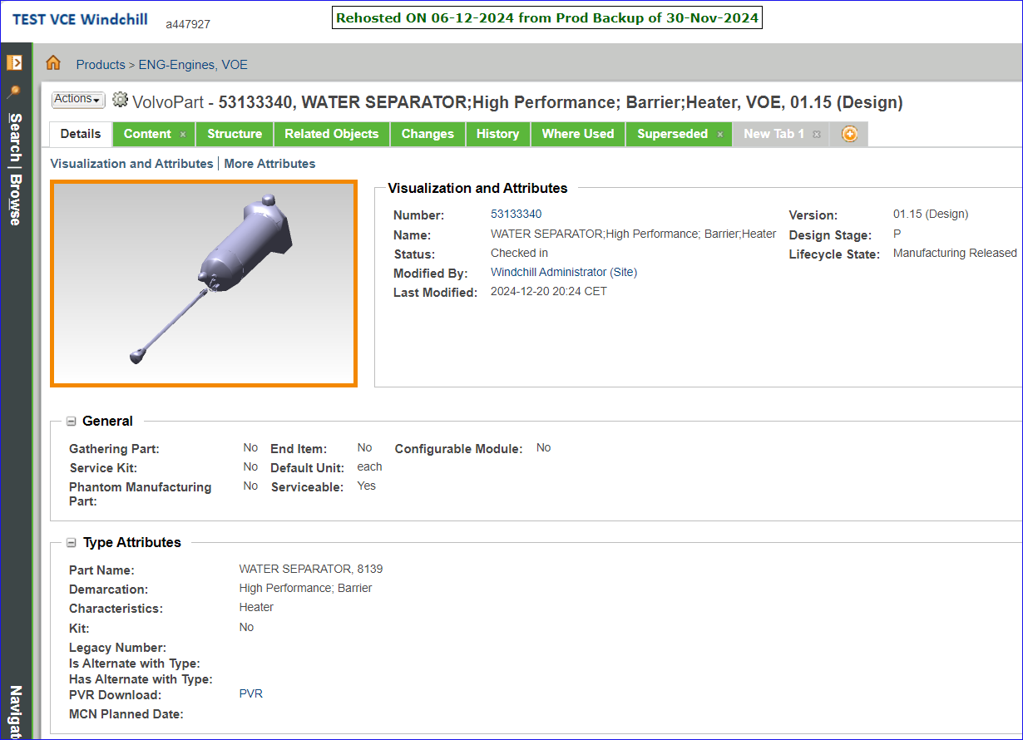
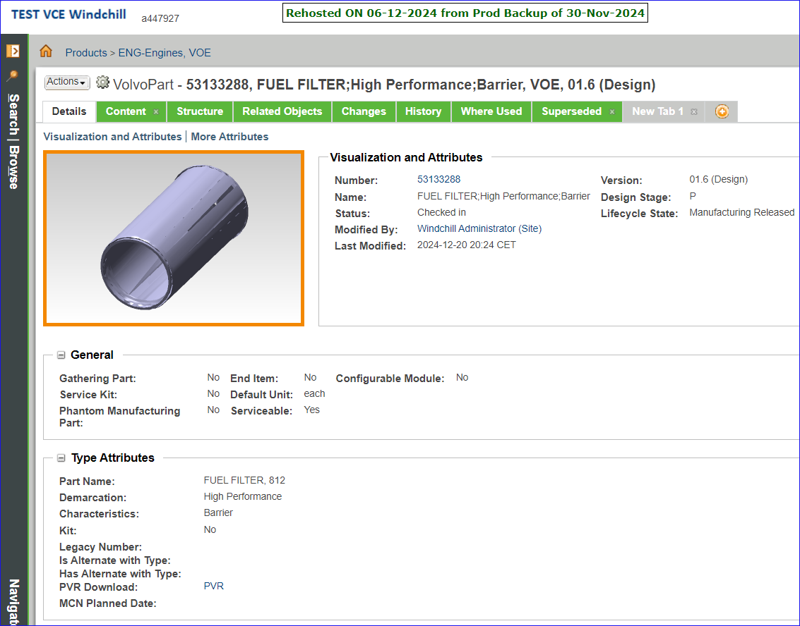
53133340
53133288

Slide 4
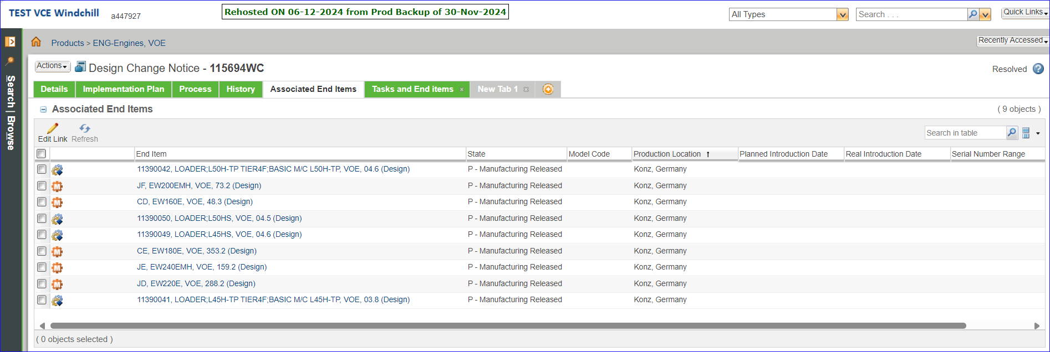
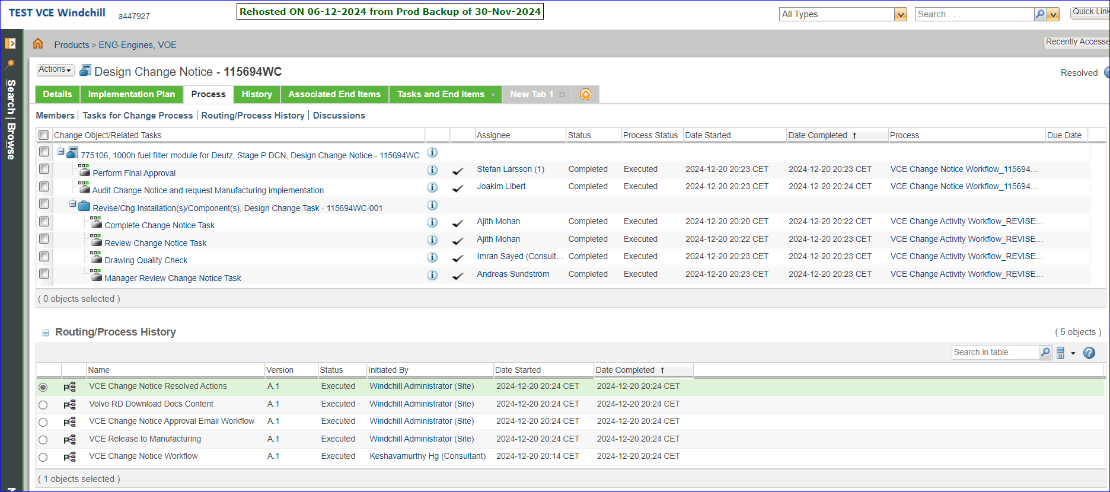
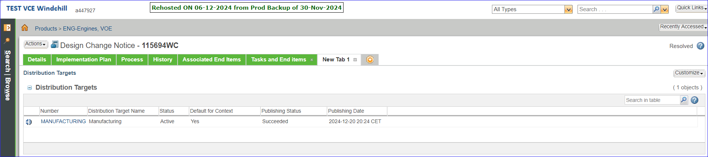
115694WC
End item business rule – In TEST environment, the DCN with Volvo part has checked for an end item associated with it.
Distribution targets are triggered for all plant views – In TEST environment, it has triggered only for Manufacturing.

Slide 5
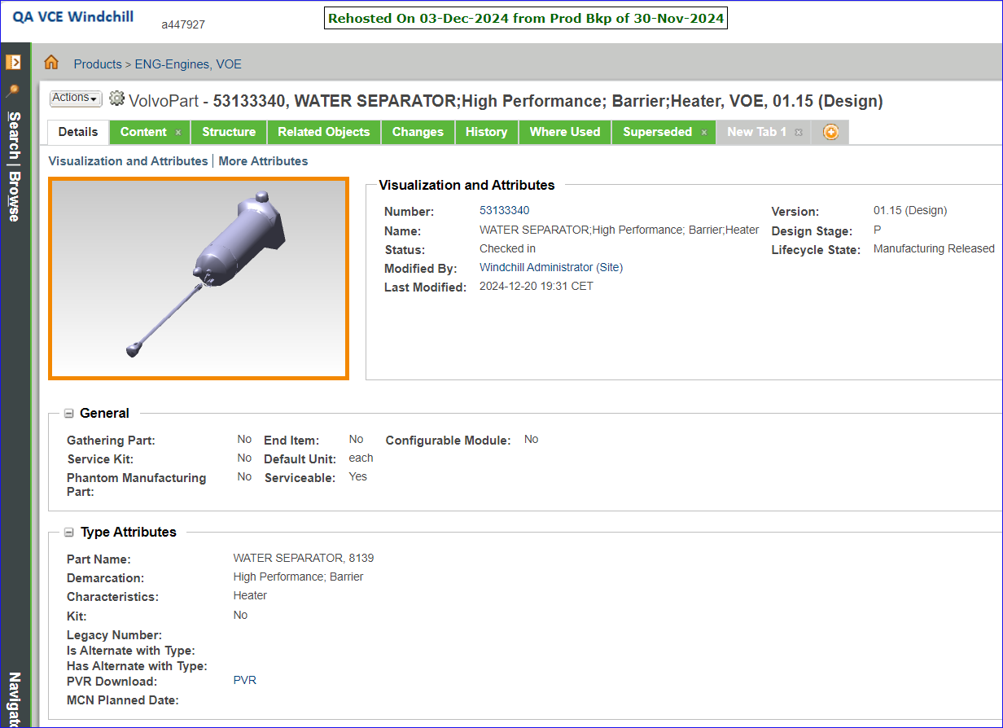
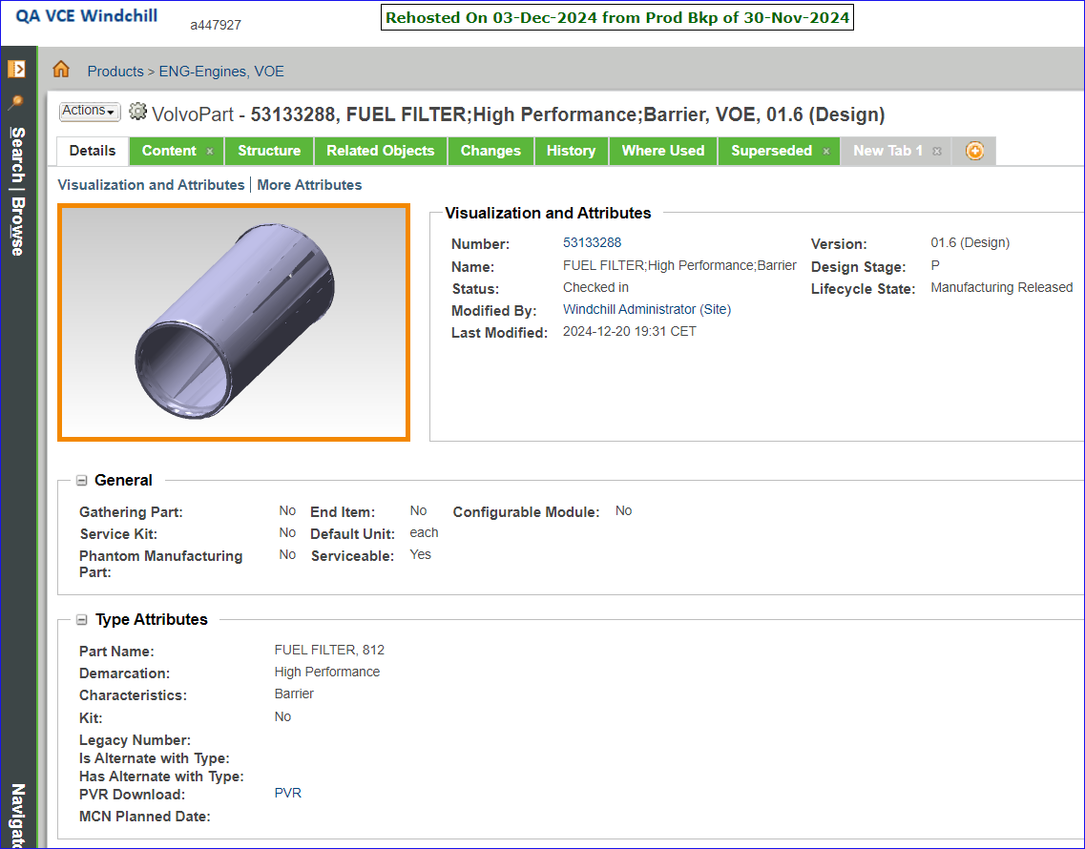
53133340
53133288

Slide 6
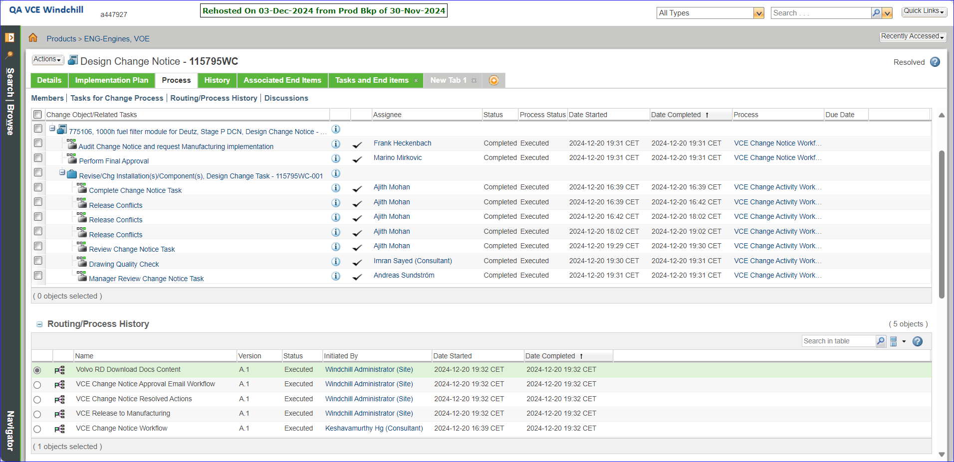
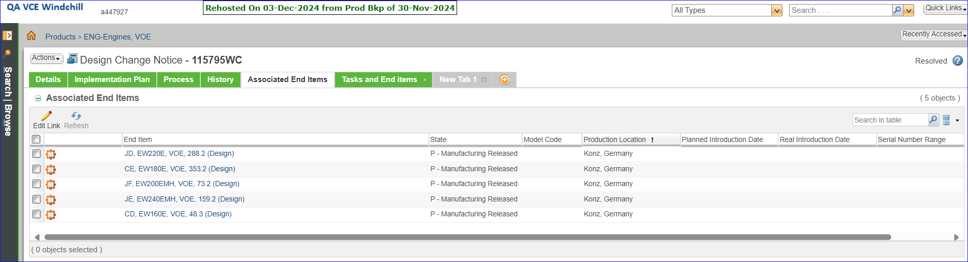

115795WC
End item business rule – In QA environment, the DCN with Volvo part has checked for an end item associated with it.
Distribution targets are triggered for all plant views – In QA environment, it has triggered only for Manufacturing.

